Slide 1
FINAL PROJECT
Dor Shaul, Amir Linder, Omri Biton

Slide 2
ABOUT OUR PROJECT
Lockdown
Is when citizen must stay at home, businesses and industries are fully closed except for essential jobs.
The purpose
Is to investigate the changes in power consumption during lockdowns.
The findings
can help the Ministry of Energy and the IEC prepare for similar extreme situations in terms of resources for electricity generation and storage.

Slide 3
RESEARCH QUESTIONS
On our main question we will investigate the relationship between power consumption and a lockdown during the Covid-19. We will examine whether the power consumption during lockdowns in Israel and in USA can be predicted.
In addition, we would like to examine the differences in consumption on weekends and holidays compared to weekdays.

Slide 4
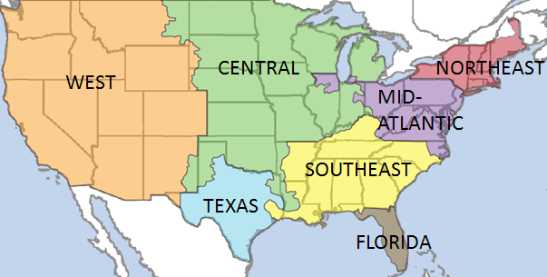
Our Data is 2 files of 2020, half-hourly SMP value in Israel and Hourly power demand in USA.
In the SMP data we have added a weekday/weekend and a holiday columns. We focused on the 2 regions with the highest demand and demand forecast. TEX – Texas and MIDA – Mid-Atlantic.

Slide 5
DATA PREPARATION
OUTLIERS
MISSING VALUES
CORRELATION
In both data we found outliers and decided not to erase them.
We filled missing values in MIDA by the average values.
In MIDA & TEX there was Correlation to Net_Generation

Slide 6
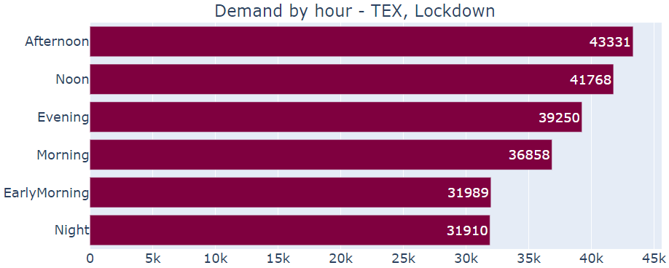
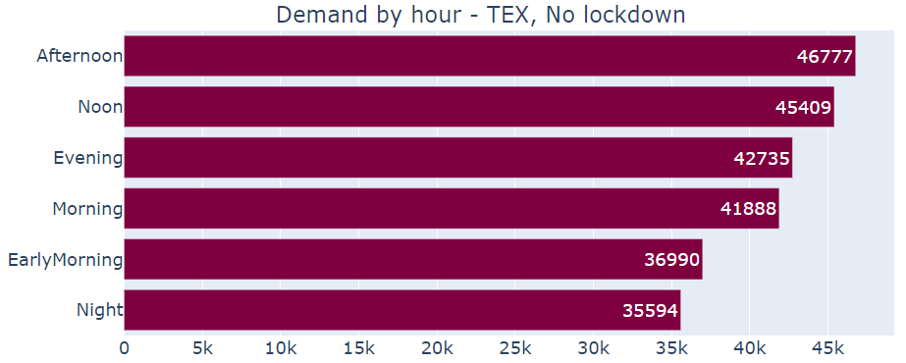
Hourly power consumption in TEX

Slide 7
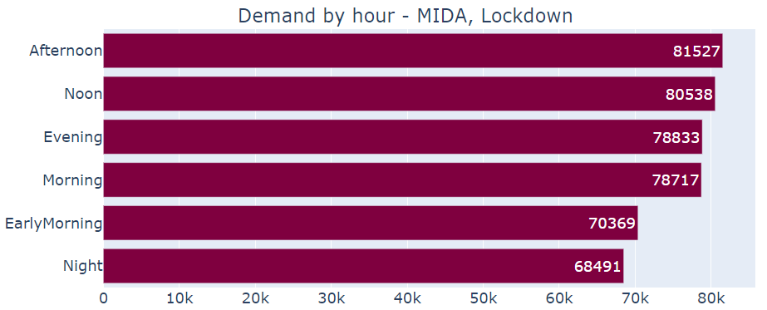
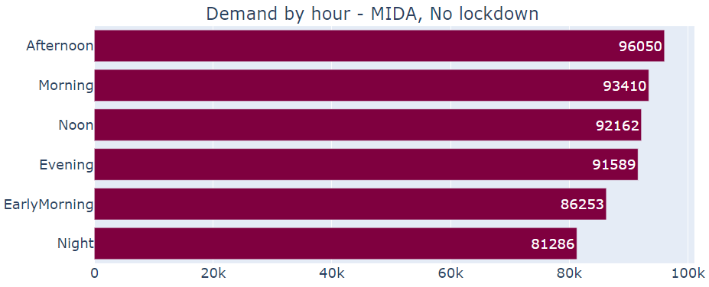
Hourly power consumption in MIDA

Slide 8
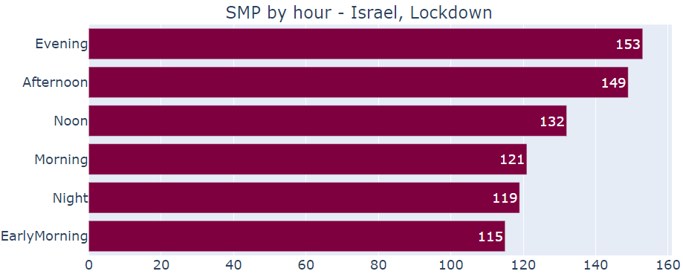
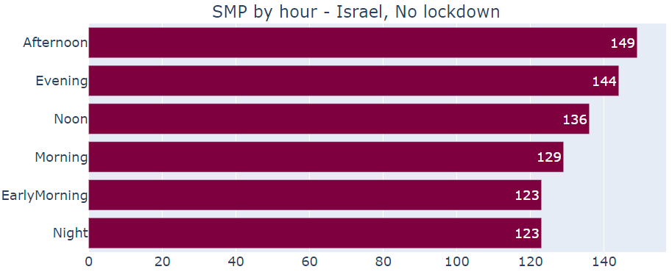
Hourly power consumption in ISRAEL

Slide 9
T-Test
We examined power consumption on equal period of times during lockdowns and no lockdowns: First week in lockdown & last week before the lockdown and First month in lockdown & a month before with no lockdown.
H0: Lockdowns do not affect the power consumption.
H1: Lockdowns do affect the power consumption.

Slide 10
T-Test
Month before | First month | Week before | First week
Reject H0 | P = 0 |  | Reject H0 | P =0.0002 |  | MIDA
86,661 | 74,693 | 81,532 | 79,055 | Average:
Reject H0 | P =0.0315 |  | Accept H0 | P =0.5193 |  | TEX
38,054 | 37,452 | 38,174 | 37,783 | Average:
Reject H0 | P = 0 |  | Accept H0 | P =0.1302 |  | ISRAEL 1st lockdown
140 | 126 | 139 | 136 | Average:
Reject H0 | P =0.017 |  | Reject H0 | P =0.0006 |  | ISRAEL 2nd lockdown
142 | 140 | 150 | 144 | Average:

Slide 11
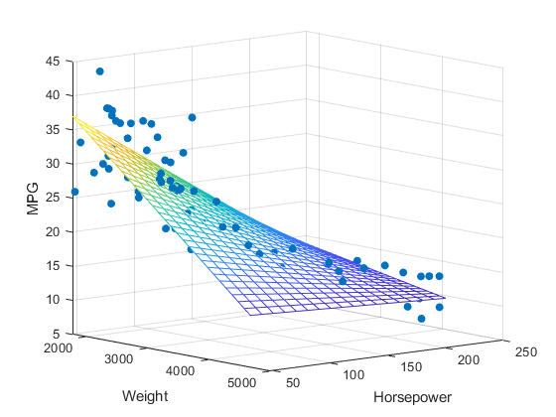
Multivariate linear regression
We made sure that the accurate algorithms could predict well
Train RMSE ≈ Test RMSE
RMSE << STDy

Slide 12
COEFFICIENT - TEXAS
Temp, Noon & Afternoon have a positive effect on power consumption especially during lockdown.
Night & Early Morning have a negative effect on power consumption.

Slide 13
COEFFICIENT – MID ATLANTIC
Temp, Noon & Afternoon have a positive effect on power consumption.
Night, Early Morning & Is_Weekend have a negative effect on power consumption.
Beside Night, Morning & Afternoon all other parameters have stronger effect during lockdown.

Slide 14
COEFFICIENT - ISRAEL
Temp, Evening & Afternoon have a positive effect on power consumption.
Night, Early Morning & Morning have a negative effect on power consumption.
All parameters have stronger effect while Lockdown.

Slide 15

RANDOM FOREST
We made sure that the accurate algorithms could predict well
Train RMSE ≈ Test RMSE
RMSE << STDy

Slide 16
IMPORTANCE
 | TEX - Texas | MIDA – Mid Atlantic | SMP – Israel
Lockdown | Temperature(0.23) Afternoon(0.19) Early morning(0.17) | Temperature(0.52) Night(0.18) Early morning(0.16) | Temperature(0.42) Afternoon(0.25) Evening(0.22)
No Lockdown | Temperature(0.48) Night(0.12) Afternoon(0.09) | Temperature(0.52) Night(0.2) Early morning(0.15) | Temperature(0.57) Afternoon(0.17) Evening(0.13)

Slide 17
CONCLUSIONS
In Israel and in USA, temperature is the variable that most significantly affects power consumption (especially during lockdwons).
Consumption hours during the day have a strong effect on power consumption, both negative and positive.
In both Israel and USA, power consumption decreases
during the lockdwon.
In Israel, there is no effect of the weekend variable on power
consumption.
In USA, on the other hand, the effect of this variable
on power consumption is negative.

Slide 18


